Slide 1
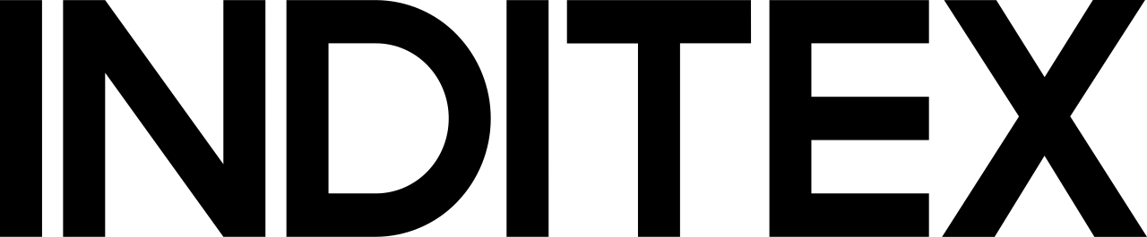
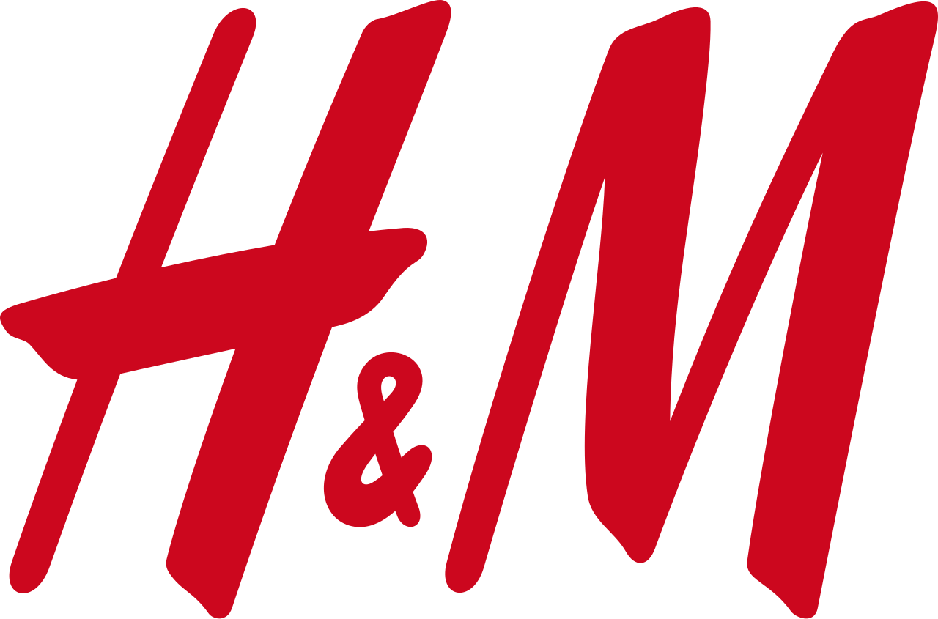
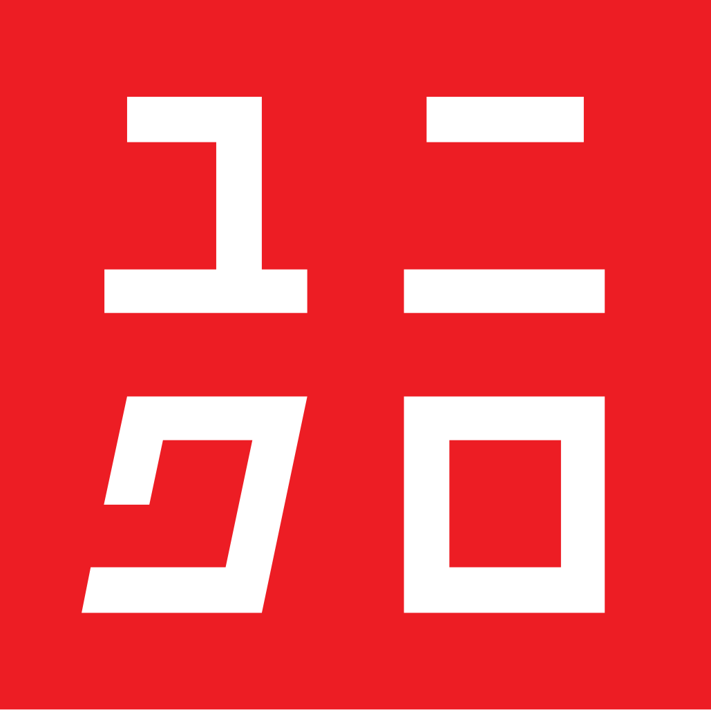
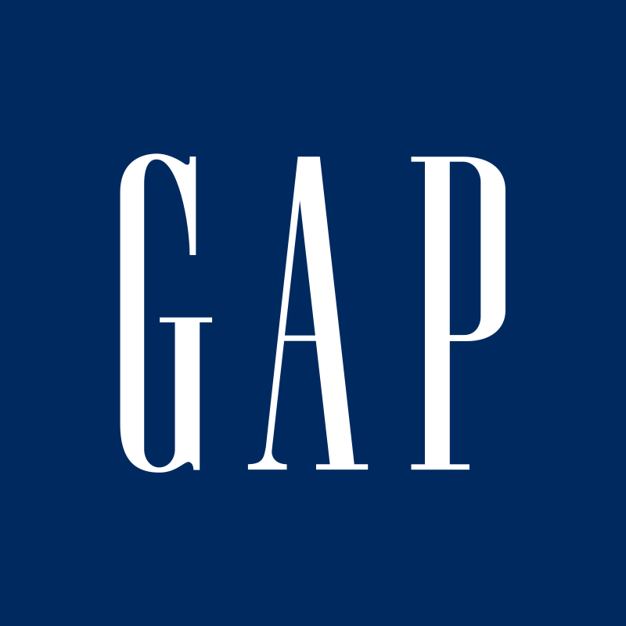
Fast Fashion Competitors: Business / Market Strategy
Inditex (Zara), H&M, UNIQLO (Fast Retailing), Gap Inc.
Inditex
H&M
Integrated store + online model across 200+ markets; continuous store optimisation and e-commerce growth.
Customer-first “newness” engine: daily store feedback + sales data used to anticipate trends and adjust the offer quickly.
Differentiation pillars: product proposition, customer experience, sustainability, and people.
Mass-market fashion with a value promise on style, quality, price and sustainability.
Omnichannel focus: “elevated experience across all sales channels” to match local demand.
Using data to improve local relevance (assortment, pricing, allocation) and reduce overproduction.
UNIQLO
Gap Inc.
LifeWear positioning: functional, high-quality “everyday essentials” vs. trend-chasing fashion.
SPA model enables control from planning/design through retail; scales core items globally.
Growth agenda: build a “digital consumer retail” model (Ariake Project) linking partners, warehouses and stores.
Portfolio strategy: value-led Old Navy plus Gap, Banana Republic and Athleta targeting distinct segments.
Omnichannel retailer with shared capabilities (BOPIS, ship-from-store) to unify store and digital journeys.
Near-term priorities: operational rigor, brand reinvigoration, and a stronger digital-first platform.

Slide 2
Operations Strategy: Supply Chain & Execution
How each competitor turns design intent into inventory on the floor (and online)
Inditex
H&M
Highly integrated value chain (design → procurement/manufacturing → logistics → store/online sales).
Proximity + short production series for flexibility and in-season response; significant procurement close to HQ.
Tech-enabled execution: RFID + integrated stock management (SINT) unifies inventory across stores and online.
Demand-driven supply chain designed to react quickly to trends and shifting customer demand.
All production is outsourced; invests in logistics/automation and the flow of goods; speed, availability, cost efficiency and accuracy are key.
Applies AI + data across the supply chain for better quantification, allocation and pricing (leaner production).
UNIQLO
Gap Inc.
SPA model: direct control of design/planning and tight orchestration of production, distribution and retail.
Outsources most production to long-term partner factories; production offices + “Takumi” teams support quality.
Large-lot core items with in-season production adjustments based on monitored sales to limit over/understock.
All products manufactured by independent third parties; execution depends on vendor capacity and compliance.
Operational focus: optimize inventory, improve supply chain efficiency/responsiveness, and enable in-season response.
Shared platform investments support omni-channel fulfillment (BOPIS, ship-from-store) and distribution centers.

